Slide 1
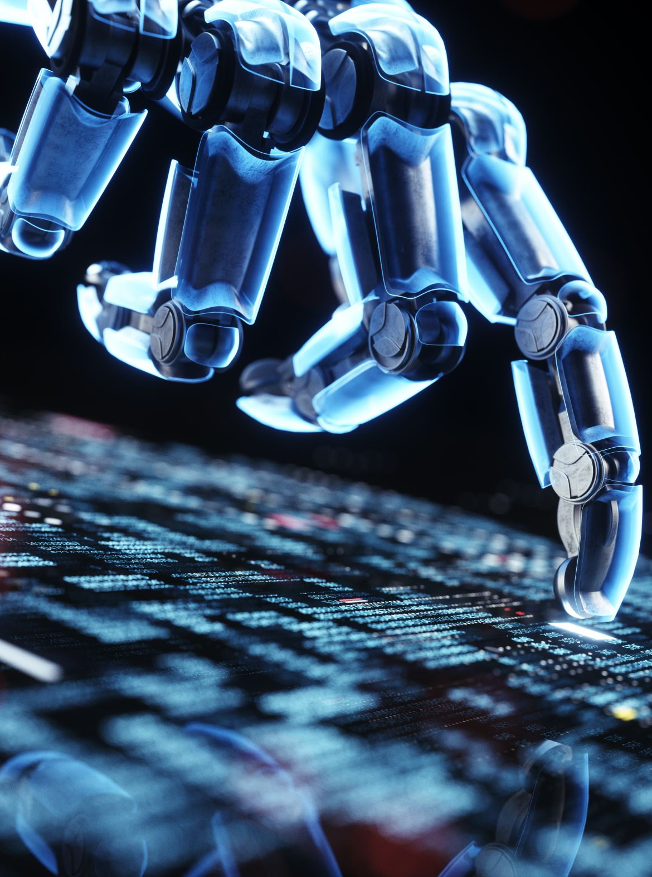
Artificial Intelligence and the Associated Threats
Anish Ghimire
Ghimire.An@cwu.edu

Slide 2
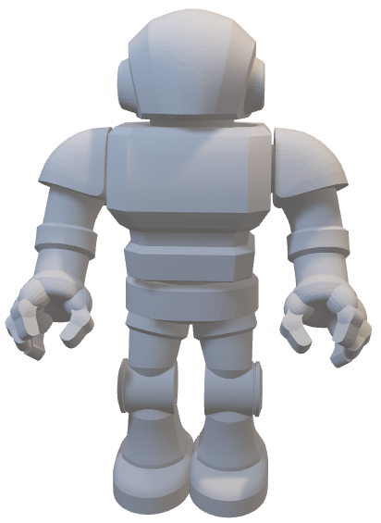
Artificial Intelligence
Artificial intelligence (AI) refers to the ability of a computer or machine to mimic or replicate human-like intelligence and behaviors.
How does Artificial Intelligence work?
Identification of the task
Data collection
Use Machine Learning
Evaluation of Artificial Intelligence
Command for AI
Notes:
Artificial intelligence (AI) refers to the ability of a computer or machine to mimic or replicate human-like intelligence and behaviors. This can include tasks such as problem-solving, learning, and decision-making. AI is a broad field that encompasses a range of technologies and techniques, including machine learning, natural language processing, and robotics.

Slide 3

Topics to be covered
Importance of AI
Future Trajectory of AI
Threats of AI
Should AI be everyone’s concern?
Notes:
Artificial intelligence (AI) refers to the ability of a computer or machine to mimic or replicate human-like intelligence and behaviors. This can include tasks such as problem-solving, learning, and decision-making. AI is a broad field that encompasses a range of technologies and techniques, including machine learning, natural language processing, and robotics.

Slide 4
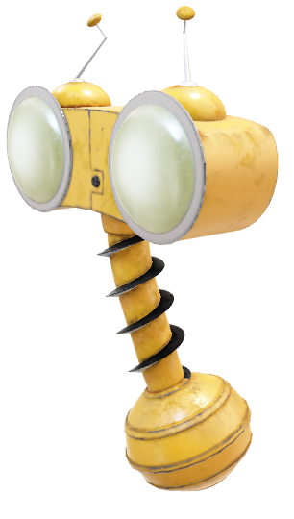

Importance of AI
Improving Decision Making
Automating tedious or repetitive tasks
Analyzing data and statistics that can inform decision-making strategy
Providing quick insights into different sectors
Notes:
AI has the potential to improve decision-making and productivity in a wide range of industries, from healthcare and finance to transportation and retail.
AI can help businesses and organizations operate more efficiently and effectively by automating tedious or repetitive tasks, freeing up human workers to focus on more complex and creative work.
AI can also help to analyze large amounts of data quickly and accurately, providing insights and predictions that can inform decision-making and strategy.
In some cases, AI can help to improve the customer experience by providing personalized recommendations or assistance.
AI has the potential to help address complex global challenges, such as climate change and disease, by providing new tools and insights for researchers and policymakers.
Overall, AI has the potential to drive innovation and progress in many areas, improving our lives and the world we live in.
While AI is significant in the coming generation, the trajectory AI is on appears attractive.

Slide 5


Future Trajectory of AI
Three stages of AI
Narrow, General, and Super AI
Usage of AI in a wide range of fields
AI vs. Human Jobs
Notes:
Narrow; speech recognition and self-driving cars
General; that can show human intelligence
Super; surpassing humans with a level where machines can do any task
Health, Transportation, Cybersecurity, Education, Autonomous vehicles

Slide 6


Threats of AI
Privacy Concerns
Bias and discrimination
Loss of jobs
Loss of control
Notes:
Privacy concerns: The use of AI raises concerns about the collection and use of personal data and the potential for the misuse of such data by malicious actors.
Bias and discrimination: AI systems can sometimes reflect the biases of their creators, leading to discriminatory outcomes.
Loss of jobs: As AI technology improves and becomes more widespread, it could lead to the automation of many jobs currently performed by humans, potentially leading to widespread unemployment.
Loss of control: As AI systems become more advanced, it is possible that humans may lose control over their functioning and behavior, potentially leading to disastrous consequences.

Slide 7


Myths of AI
Fake news!!!
Threat to humanity?
AI can never be creative
AI will always be biased
Notes:
AI is a threat to humanity: This is a common fear, but the current state of AI technology does not support it. While AI systems can potentially pose risks and challenges, they are not inherently dangerous and can also be used for positive purposes.
AI can never be creative: Some people believe that creativity is a uniquely human trait and that AI systems will never be able to exhibit true creativity. However, AI has already shown some ability to generate creative content, such as music and art, and this ability is likely to improve in the future.
AI will always be biased: While it is true that AI systems can sometimes reflect the biases of their creators, this does not mean that all AI is inherently biased. AI developers are working to design systems that are fair and unbiased, and there are also techniques that can be used to mitigate bias in AI systems.

Slide 8

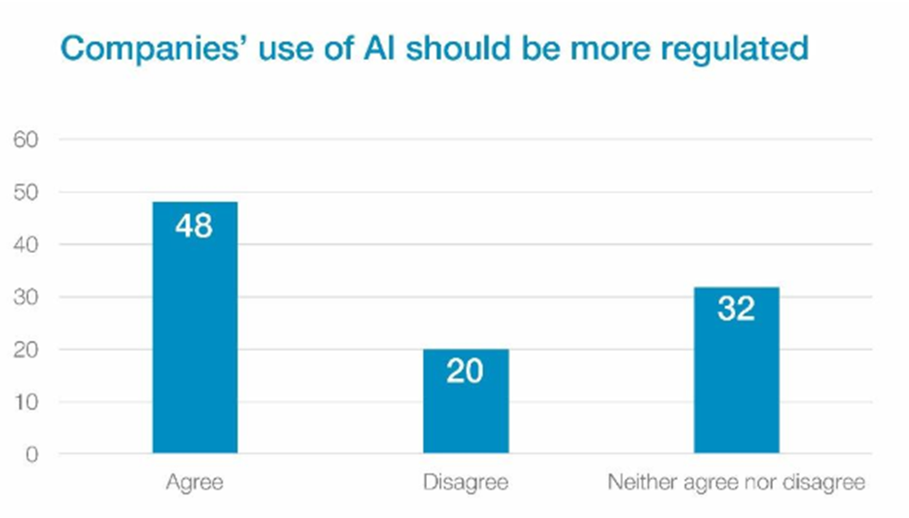
Should AI safety be everyone’s concern?
The poll above was conducted by (Bécue et al., 2021) and how businesses feel about whether AI needs to be more controlled.
Notes:
AI has the potential to impact everyone: The development and use of AI has the potential to affect all aspects of society, from the economy and job market to healthcare and personal privacy. As such, it is important for everyone to be aware of the potential risks and challenges posed by AI and to consider how these can be addressed.
AI safety is a collective responsibility: Ensuring the safety and ethical use of AI is not just the responsibility of AI developers and researchers, but of society as a whole. It requires collaboration and input from a wide range of stakeholders, including policymakers, industry leaders, and the general public.
AI safety is an ongoing process: The field of AI is rapidly evolving, and new challenges and risks are likely to arise as the technology continues to advance. As such, ensuring the safety of AI requires ongoing attention and effort from all members of society.

Slide 9
Conclusion
Importance of AI is immeasurable
Future Depends on AI
Threats of AI are concerning

Slide 10

Questions?
Ghimire.An@cwu.edu

Slide 11

Thank You!!!

Slide 12
References
Alekseev, R. (2020). Artificial Intelligence in the service of the State: pros and cons. Journal of Political Research, 4(2), 58–69. https://doi.org/10.12737/2587-6295-2020-58-69
Anastasi, S., Madonna, M., & Monica, L. (2021). Implications of embedded artificial intelligence - machine learning on the safety of Machinery. Procedia Computer Science, 180, 338–343. https://doi.org/10.1016/j.procs.2021.01.171
Bécue, A., Praça, I., & Gama, J. (2021). Artificial Intelligence uses approved by companies graph[PNG] https://assets.weforum.org/editor/large_5YfwKuLDdrYvjHYrQ5SHLyIq1jNuKKJz_LuMMdsQSlc.jpg
Blake, R. W., Mathew, R., George, A., & Papakostas, N. (2021). Impact of artificial intelligence on engineering: Past, present, and future. Procedia CIRP, 104, 1728–1733. https://doi.org/10.1016/j.procir.2021.11.291
Grundner, L., & Neuhofer, B. (2021). The bright and dark sides of Artificial Intelligence: A futures perspective on tourist destination experiences. Journal of Destination Marketing & Management, 19, 100511. https://doi.org/10.1016/j.jdmm.2020.100511
Nekrasov, V. (2019). Artificial Intelligence in criminal law: Pros and cons. Baikal Research Journal, 10(4). https://doi.org/10.17150/2411-6262.2019.10(4).20
Ruess, H. & Burton, S. (2022). Safe ai – how is this possible? Artificial Intelligence (cs.AI), FOS: Computer and information sciences.
Souhail, E., Elodie, H., M. Ammar, A., & Chance, E. (2020). Will Artificial Intelligence (AI) Take over the Construction World? - A Multidisciplinary Exploration. https://doi.org/10.3311/ccc2020-010
Walsh, T. (2018). 2062: The World Ai made. La Trobe University Press in conjunction with Black Inc.

